Slide 1

Subtask 2: Transition from Handwritten Name to Holiday Greeting
A Dynamical Systems Approach to Swarm Robotic Reconfiguration

Slide 2


Objective and System Overview
This segment details the objectives and fundamental components guiding the swarm's transition from a handwritten name formation to a static holiday greeting.
1
Input State
Swarm configured as the final state of Subtask 1 (handwritten name formation).
2
Target Output
A visually stable, static "Happy New Year!" greeting.
3
Desired Outcome
Smooth, collision-free trajectories enabling a clear visualization of the transition.

Slide 3
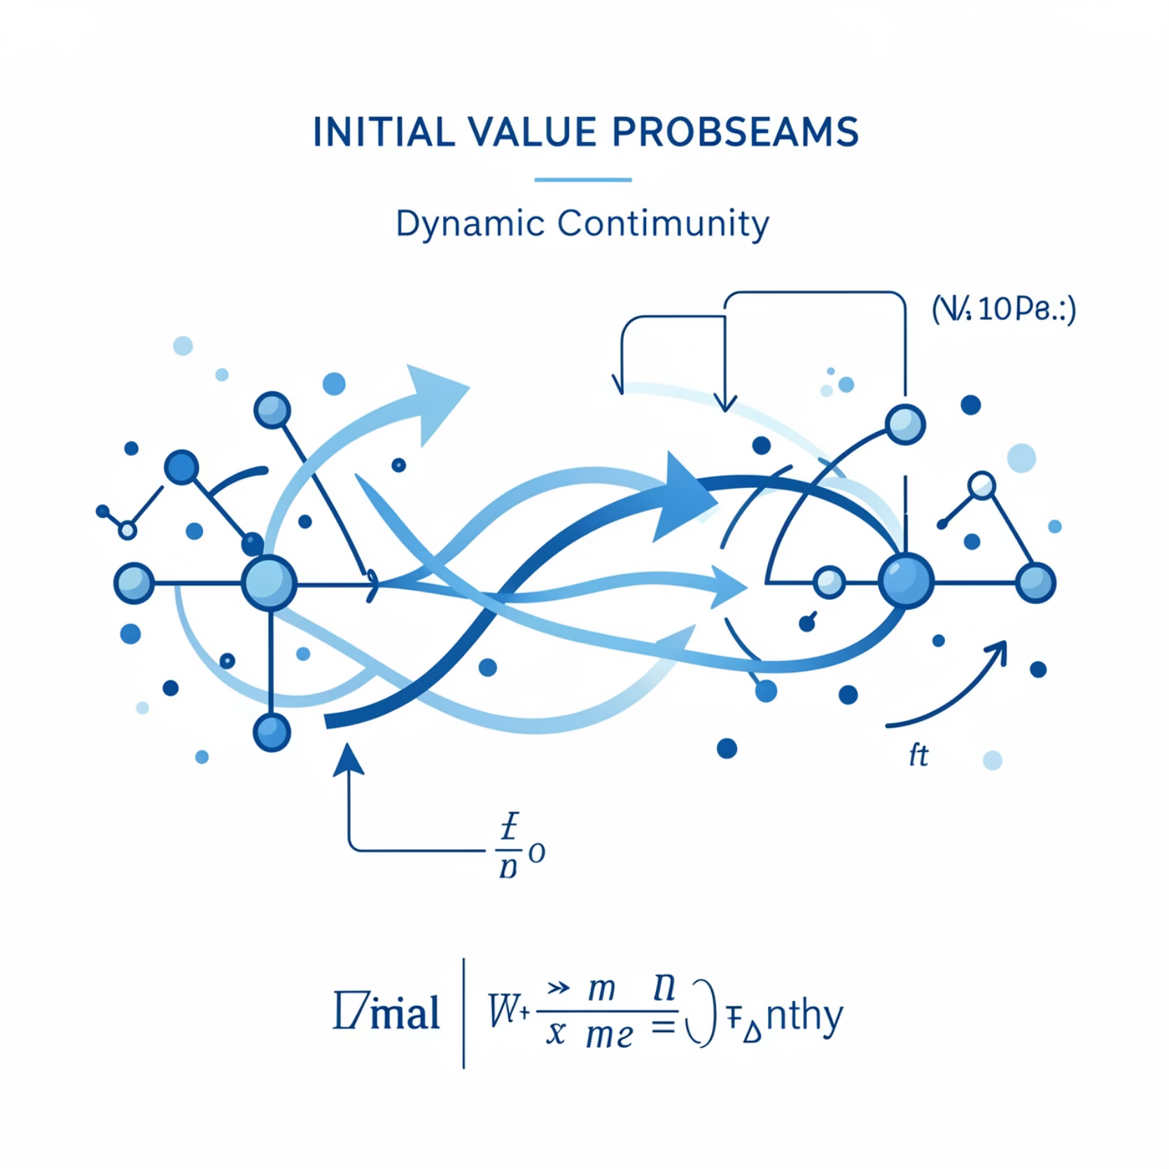
Initial Value Problem (IVP) Formulation
The transition problem remains an Initial Value Problem, inheriting its initial conditions directly from the preceding task, ensuring continuity.
The initial condition for Subtask 2 is precisely the final state achieved in Subtask 1, maintaining dynamic continuity:
This formulation ensures that the swarm's starting positions and velocities for the greeting formation are coherent with their prior configuration, preventing abrupt discontinuities.

Slide 4
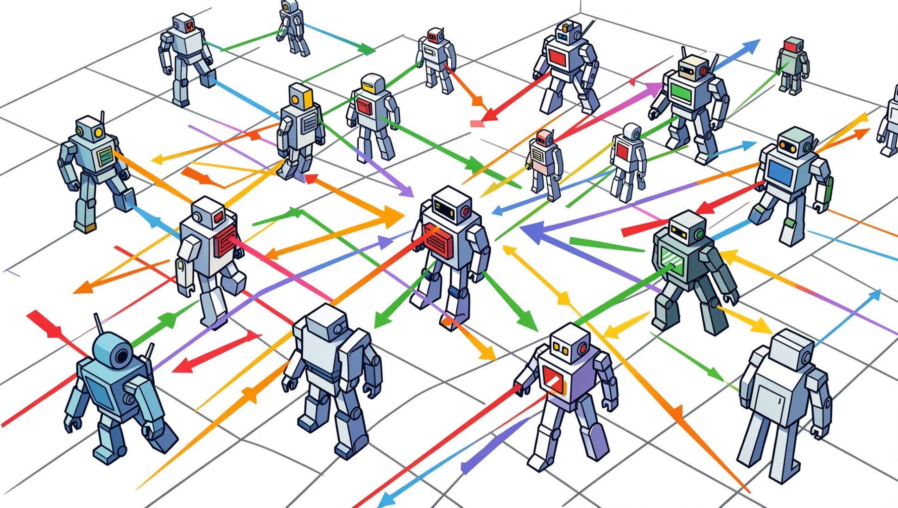
Core Dynamics and Velocity Constraints
The underlying control laws from Subtask 1 are preserved, with an added velocity saturation mechanism to maintain physical realism.
Invariant Equations of Motion
The same IVP equations utilized for static target adherence in Subtask 1 are applied here, forming the foundation for the swarm's movement dynamics.
Velocity Saturation
To prevent unrealistic accelerations and maintain control stability, a velocity saturation mechanism is rigorously enforced, limiting individual agent speeds.
Smooth Trajectories
These dynamics, coupled with saturation, ensure a physically plausible and visually smooth transition between formations.

Slide 5
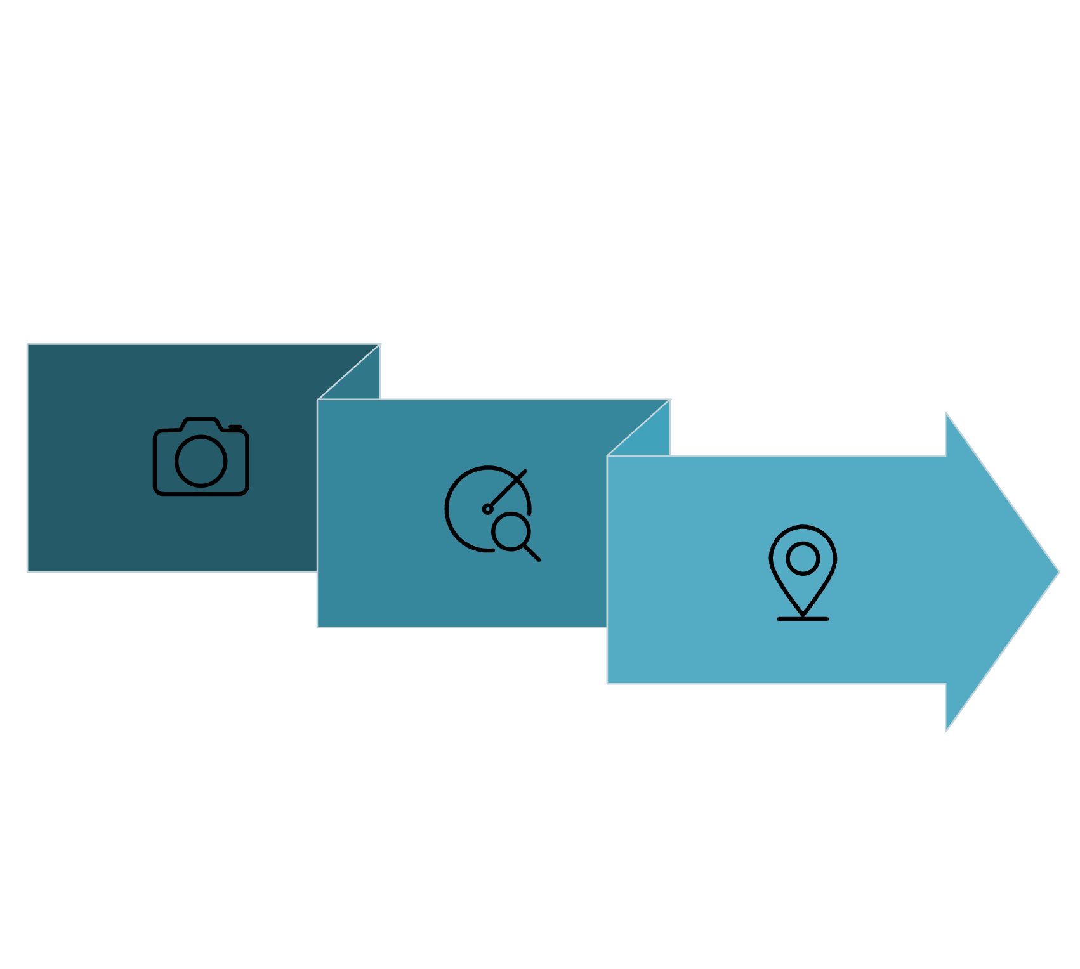

New Target Formation: "Happy New Year!"
The target configuration for the holiday greeting is meticulously extracted and processed from a static image to define the swarm's desired final state.
Image Acquisition
Point Sampling
Edge Detection
The "Happy New Year!" greeting image undergoes a robust digital processing pipeline. Initially, edge detection algorithms (Canny and Otsu) identify the contours, followed by strategic sampling to extract target points that the individual swarm agents will converge upon.

Slide 6

Transition Scheduling and Pacing
Careful scheduling defines the temporal evolution of the transition, including the duration and "hold" phases for stability.
Define T
Establish the overall time horizon for the transition.
Frame Rate
Determine the number of frames per second for smooth animation.
Steps per Frame
Specify the numerical integration steps within each frame for precision.
Hold Frames
Incorporate static "hold" frames at the end to ensure the greeting remains stable and legible.
This structured approach ensures that the dynamic transition is visually coherent and culminates in a static display that is both stable and easily discernible by the observer.

Slide 7
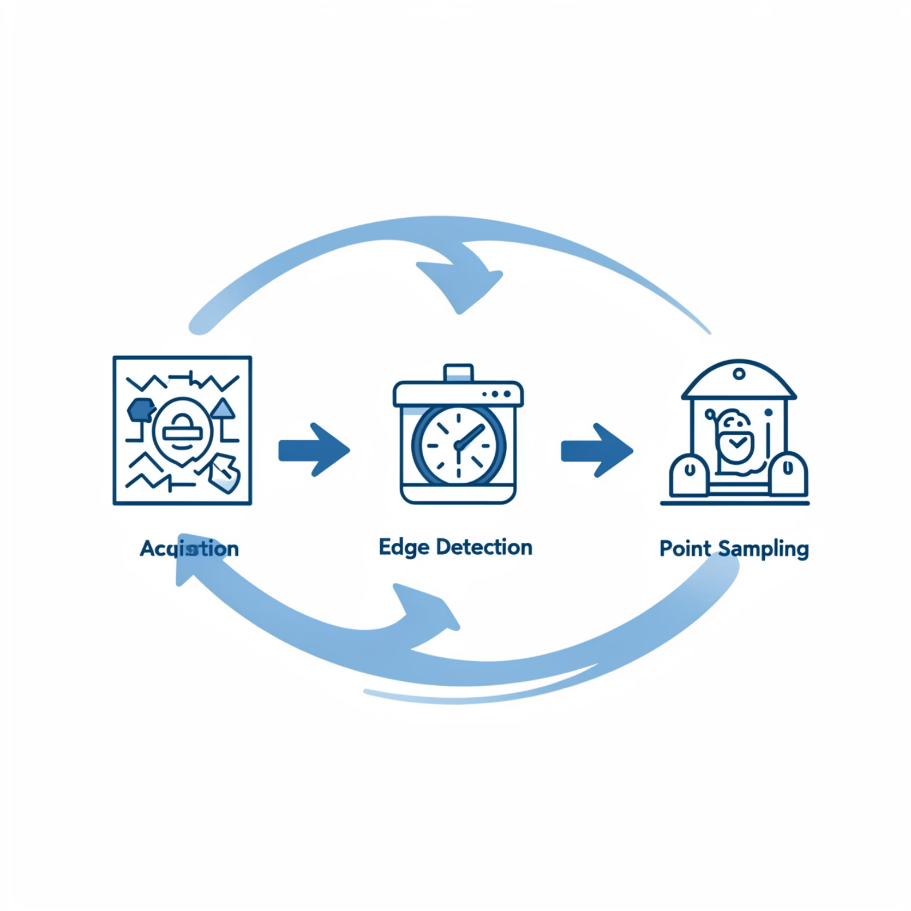
Numerical Integration: The RK4 Solver
The robust Runge-Kutta 4th order method (RK4) is continuously employed for numerical integration, preserving computational stability and accuracy.
Solver Consistency
The same RK4 solver, proven effective in Subtask 1, is maintained for consistency across both tasks.
Stability Benefits
RK4 provides excellent stability properties, crucial for avoiding numerical oscillations during dynamic transitions.
Computational Efficiency
Despite its accuracy, RK4 remains computationally tractable, balancing precision with real-time simulation requirements.

Slide 8



Verification and Validation of Transition Quality
The quality of the transition is rigorously evaluated against key performance indicators, ensuring a high-fidelity and safe swarm reconfiguration.
Target Error
Monitored to confirm continuous decrease, ensuring the swarm converges accurately to the "Happy New Year!" formation.
Smoothness
Validated by bounded acceleration and velocity profiles, indicating fluid movement without abrupt changes.
Collision Avoidance
Maintained through constant monitoring of inter-agent distances, ensuring a critical safety margin.

Slide 9
Summary: From Concept to Visualization
Start State
Subtask 1 Final Configuration
IVP Initial Conditions
State Vector Import
Dependence on Subtask 1 Accuracy
New Target
"Happy New Year!" Greeting
Image Processing (Canny/Otsu)
OpenCV & Sampling
Image Quality Sensitivity
Assignment
Optimal Agent-to-Target Matching
Distance Metric Minimization
Greedy Algorithm
Potential for Local Optima
Integration
Dynamic Trajectory Generation
RK4 Method
Custom Solver Loop
Computational Complexity (N-body)
Repulsion
Collision Avoidance
Inverse Square Force
Vectorized Force Calculation
Aggressive Gains (Oscillation)
This table encapsulates the complete workflow, from defining the task requirements to their mathematical grounding and computational realization, alongside inherent limitations.

